Slide 1

Flight Data Analysis Using Exploratory Data Analysis
Exploring Fares, Durations, Airlines & Travel Patterns
Presented By:
Saran Akula
Batch No : 456

Slide 2
About me
Background : B.tech in Electronics & Communication Engineering (ECE)
At Chaitanya Bharathi Institute of Technology (CBIT)
GitHub: https://github.com/Saran-880
LinkedIn:https://www.linkedin.com/in/saran-akula-a1a6b823a/

Slide 3
Agenda
Business Problem
Objective of the project
Web Scraping details
Summary of Data
Data Understanding and Pre Processing
Data Cleaning and Manipulation
Univariate Analysis
Bivariate Analysis
Outlier Analysis
Hypothesis Testing
Conclusion

Slide 4
Business Problem
Flight ticket prices are influenced by multiple factors including airline choice, day of travel, flight duration, and departure timing.
This creates uncertainty for consumers who want to optimize travel costs, and also highlights competitive pricing strategies used by airlines in the same market.

Slide 5
Objective of the Project
Scrape flight fare data from IRCTC Air for analysis
Compare ticket prices across airlines operating on the same route
Examine weekend vs weekday fare variations
Analyze the relationship between flight duration and fare
Study price differences across departure hours
Identify value carriers and optimal fare windows for consumers

Slide 6
Web Scraping – Details
Website : Irctc air
Tools & Libraries Used: Python, Selenium, Pandas, Seaborn, Scipy
Approach:
  Scraped data from Irctc air website from different routes across different dates
  Extracted Airline Name, Source, Destination, Date, Arrival Time, Departure Time, Total Duration of journey and price.
  Saved everything into structured Data Frame for analysis

Slide 7
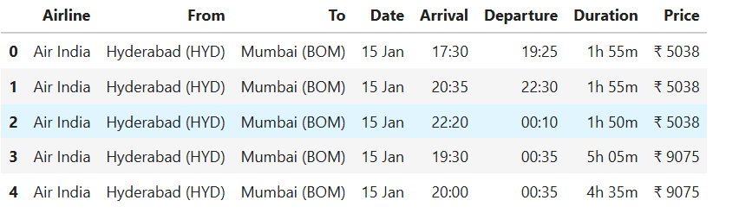
Summary Of Data
2500+ data rows of different routes across India like Hyderabad to Mumbai, Hyderabad to Goa and etc.
8 columns consisting of airline name, From(Source), To(Destination),Arrival time, Departure Time, Total Duration and price
Airlines includes Air India, Indigo, Air India Express, Spice Jet, Alliance Air and Star India.

Slide 8
Data Understanding and Preprocessing
1) Actions Performed :
  Dataset contains flight listings scraped from Irctc website.
  Each row represents one available flight option for a selected travel date.
  Columns represent pricing, timing, airline information and travel characteristics.
2) Key Columns
  Airline – Operating airline for the flight (e.g., IndiGo, Air India, Vistara).
  From / To – Origin and destination airports along with city codes (e.g., Hyderabad (HYD) → Mumbai (BOM)).
  Date – Scheduled travel date for the flight listing.
  Departure / Arrival Time – Scheduled departure and arrival times for the flight.
  Duration – Total time taken for journey including possible layovers (e.g., 1h 55m).
  Price – Final listed ticket fare for the flight (includes base fare + relevant charges).

Slide 9
Data Cleaning And Data Manipulation
Performed extensive data cleaning to ensure consistency and reliability across all scraped records.
Missing values were less than 1%, so rows were removed to maintain dataset quality.
Removed the rupee symbol from the price column as it was not needed for analysis.
Converted flight duration from hours to minutes to support meaningful comparisons.
Added a new Route column to combine source and destination.
Extracted hour components from both Arrival and Departure times to assist with later insights.

Slide 10
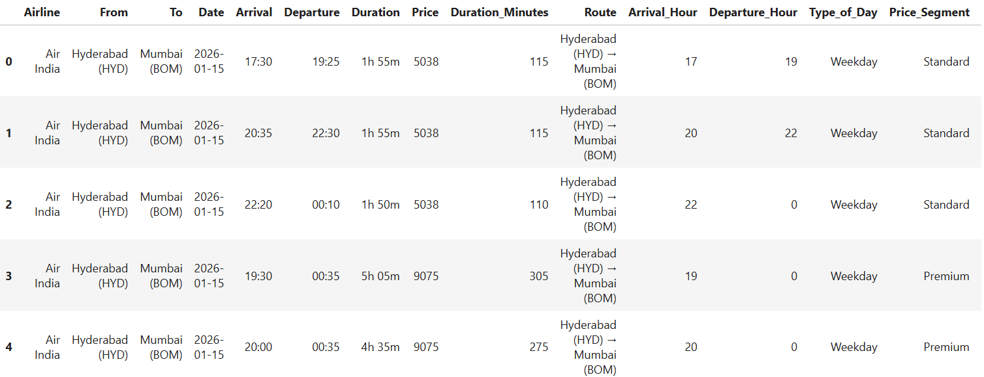
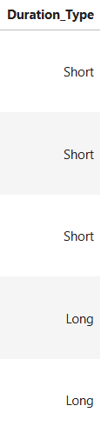
Dataset After Data Manipulation

Slide 11
Univariate Analysis
Airline — Count plot
Price — KDE Plot
Duration Minutes — Histogram + KDE
Departure Hour — Count plot
Price Segment — Pie Chart
Duration Type — Donut Pie Chart

Slide 12
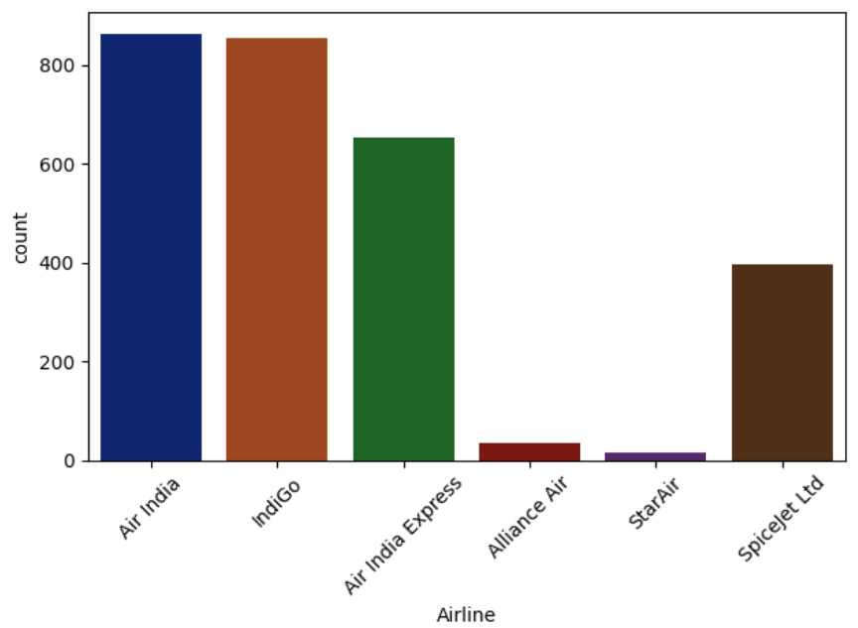
Flight Count by Airline
IndiGo and Air India operate the highest number of flights , whereas Alliance Air and Star Air have very limited presence.
This shows stronger competition between leading carriers and niche participation from smaller airlines.

Slide 13
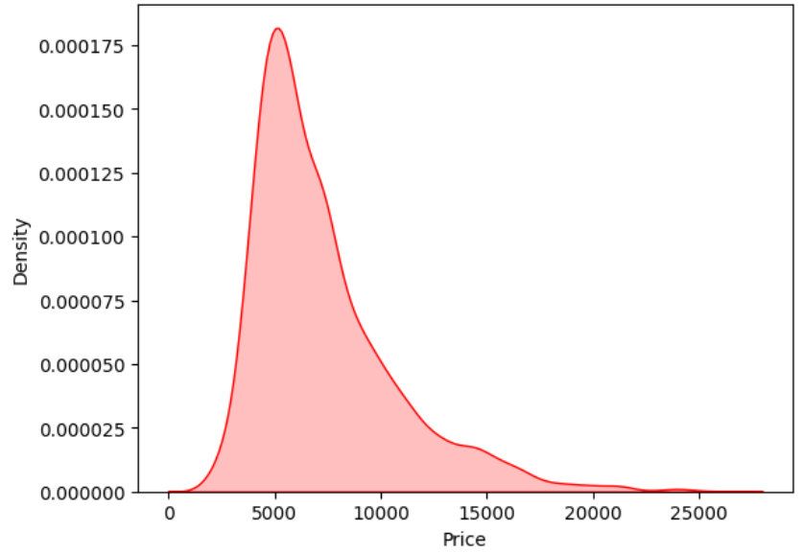
Price Density Distribution
Flight fares are mostly concentrated in lower to mid-tier price ranges, with fewer premium-priced flights.
This suggests competitive pricing behavior with occasional higher fare offerings depending on route and schedule.

Slide 14
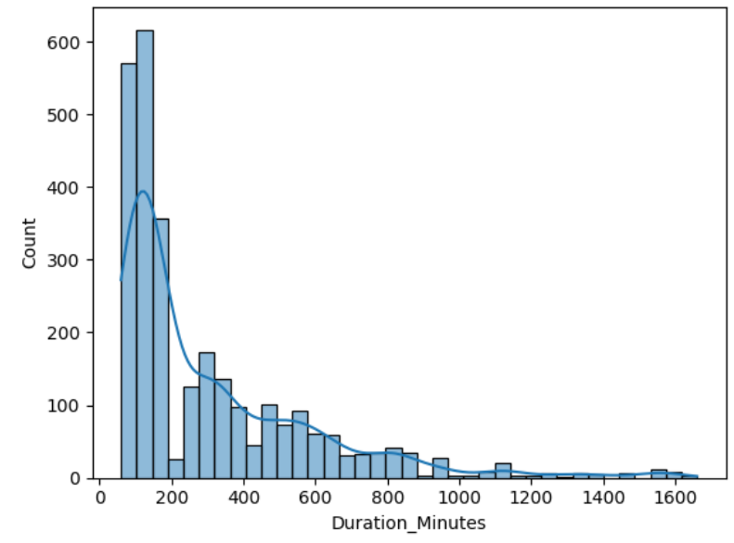
Distribution of Flight Durations
Most flights fall within short to medium duration bands, which is consistent with the domestic nature of the routes.
Longer-duration flights also appear, possibly due to indirect flights, connecting itineraries, or less efficient schedules.

Slide 15
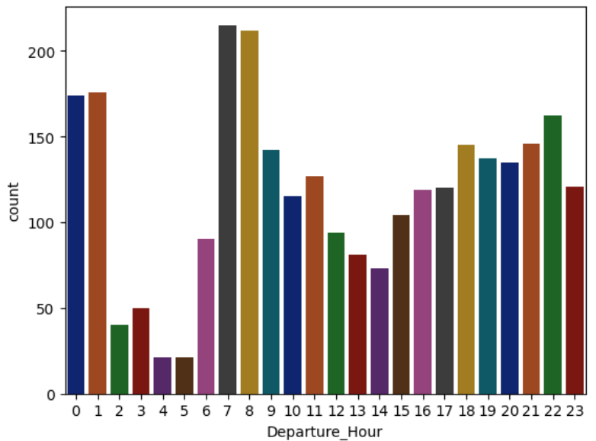
Distribution of Departure Hours
There are clear peaks in flight departures during the morning (around 7–9 AM) and evening (around 6–9 PM).
Fewer flights operate in early night and post-midnight hours. This indicates that airlines schedule more flights during passenger-preferred travel windows.

Slide 16
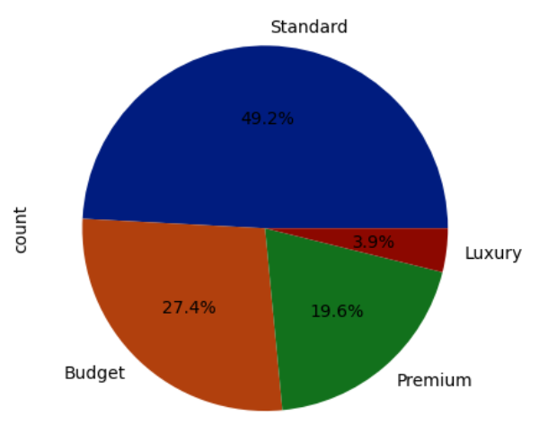
Distribution of Price Segments
Nearly half of the flights fall under the "Standard" segment, followed by "Budget" and "Premium". "Luxury" flights form a very small minority.
This indicates that the majority of flights are priced in affordable ranges rather than premium brackets.

Slide 17
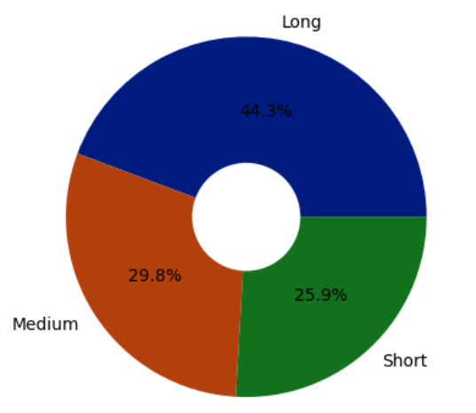
Distribution of Duration Types
Most flights fall within short to medium duration ranges.
Longer flights also appear but are fewer in number, likely due to indirect or less efficient routes.

Slide 18
Bi variate Analysis
Price Distribution Across Airlines (multiple density subplots)
Duration vs Airline (boxplot)
Price vs Type_of_Day (boxplot — Weekend vs Weekday)
Airline vs Type_of_Day (stacked)
Duration vs Price (scatter)
Price vs Departure Hour (line + confidence band)

Slide 19
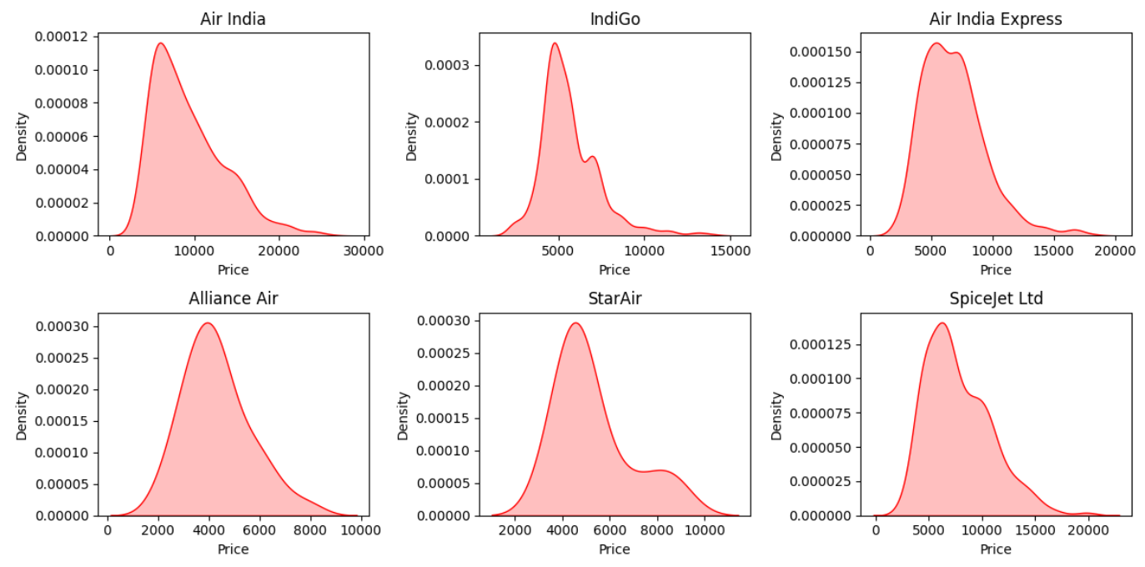
Price Density Distribution Across Airlines
Different airlines show different pricing patterns. Some have tight, consistent pricing, while others have wider spreads including premium fares.
Airlines follow different pricing strategies for the same route.

Slide 20
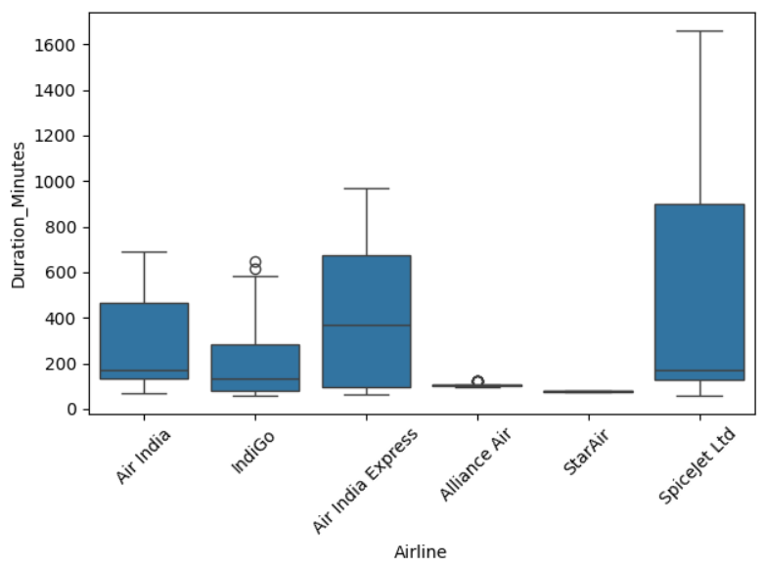
Flight Duration Across Airlines
Different airlines show different travel durations; IndiGo & Air India are mostly short and consistent, while SpiceJet & Air India Express have longer and more variable durations.

Slide 21
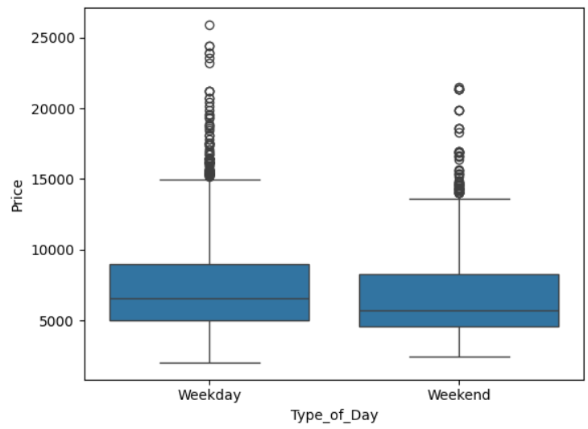
Price Comparison Between Weekdays and Weekends
Business travelers typically fly during weekdays, are less price-sensitive, and often book last-minute — leading airlines to price weekday fares at a premium.

Slide 22
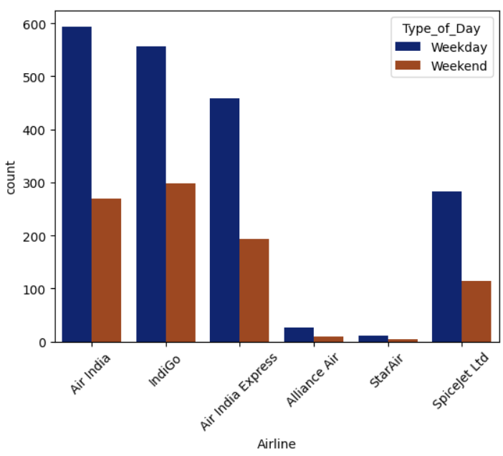
Flight Frequency by Airline and Day Type
Most flights operate on weekdays across all airlines, with weekends showing noticeably lower frequencies.
This is mainly because we have very few weekend data also airlines tend to release the tickets with hiked prices based on demand in weekends

Slide 23
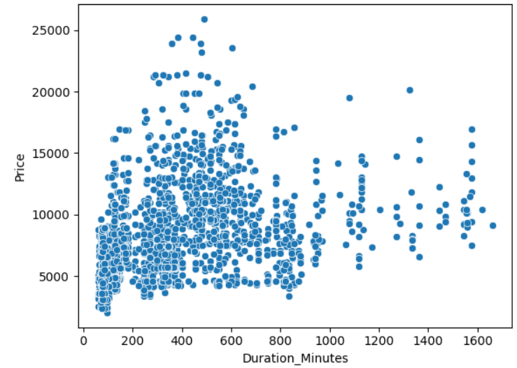
Relationship Between Flight Duration and Ticket Price
Price increases loosely with duration, but the relationship is weak and scattered, indicating that duration alone does not fully determine fare.

Slide 24
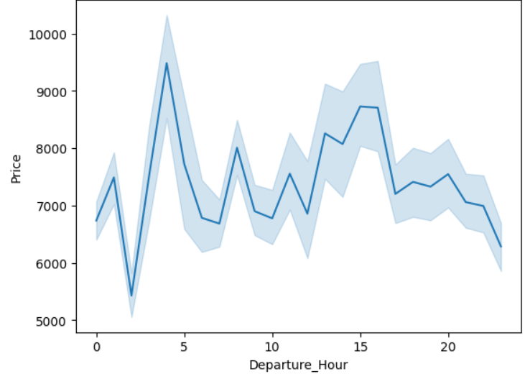
Ticket Price Variation By Departure Hour
Prices fluctuate with departure time, with higher fares around early morning and mid-afternoon, and slightly lower fares late at night.

Slide 25
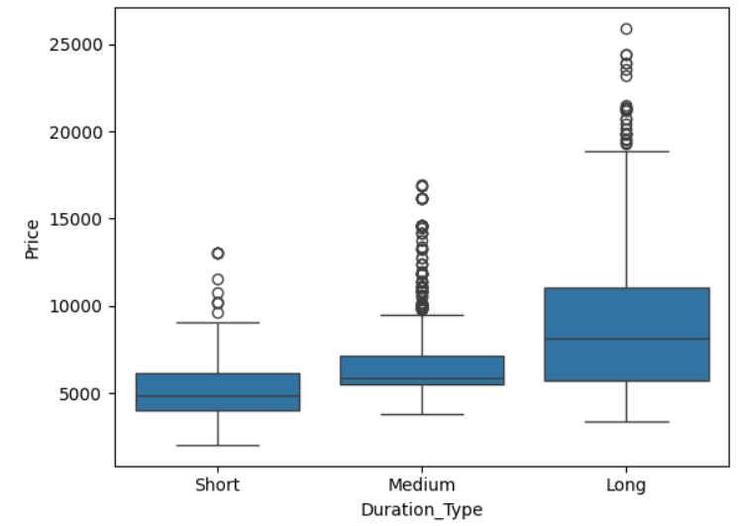
Price Variation Across Flight Duration Types
Longer-duration flights trend toward higher prices, while short-duration flights dominate Budget and Standard segments.
Flight length contributes to cost structure, but pricing is not strictly proportional to flight time. It is mainly because of many factors such as 2 or 3 stops

Slide 26
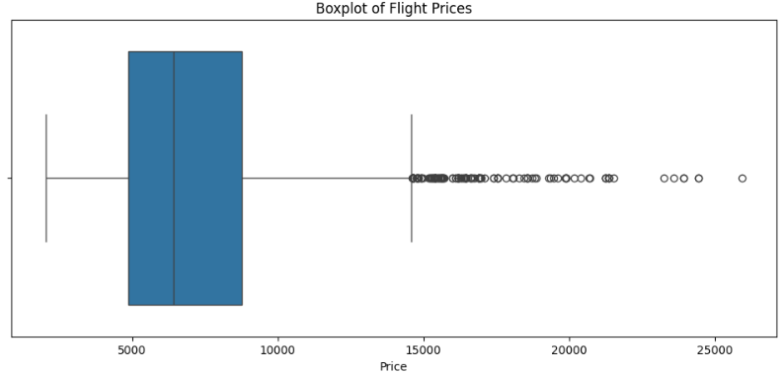
Outlier Analysis
What Happened (Analysis):
• Price distribution is right-skewed with a long tail
• Noticeable cluster of high-price points
• Outliers detected using IQR Rule
• Outliers ≈ 132 flights (~4.7%)
• Indicates heavy tails (extreme values are meaningful)

Slide 27
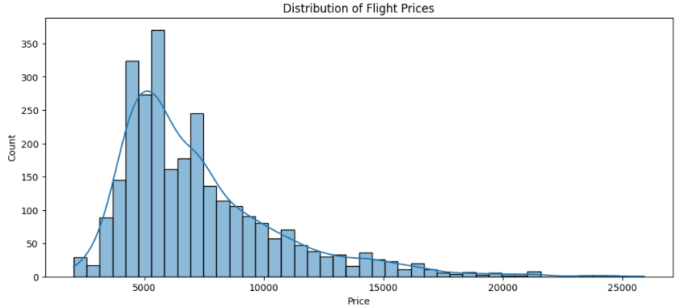
Key Observations :
Skewness: 1.56 (Right Skew)
Kurtosis: 3.02 (Heavy Tails)
IQR: 3907
Upper Outlier Cutoff: ₹14,620
Outliers: 132 flights (4.7%)
Flight price outliers represent genuine market behaviour rather than data errors. Removing them would hide important pricing dynamics, premium fare segments, and demand spikes relevant for airline pricing analysis.

Slide 28
Hypothesis Testing
What is Hypothesis Testing?
It is a method to check if a claim about data is true or not using statistics.
Why Do We Use It?
To verify patterns and differences with evidence instead of assumptions or guesswork.
What Do We Gain From It?
It helps us make confident, data-driven conclusions and avoid being misled by random variation.
Hypothesis Tested :
Hypothesis 1 : Are weekend flights more expensive than weekday flights?
Hypothesis 2 : Do different airlines charge different average ticket prices?
Hypothesis 3 : Do different flight routes have different average ticket prices?
Hypothesis 4 : Do different times of day have different average ticket prices?
Hypothesis 5 : Do airline and flight duration jointly influence ticket prices?

Slide 29
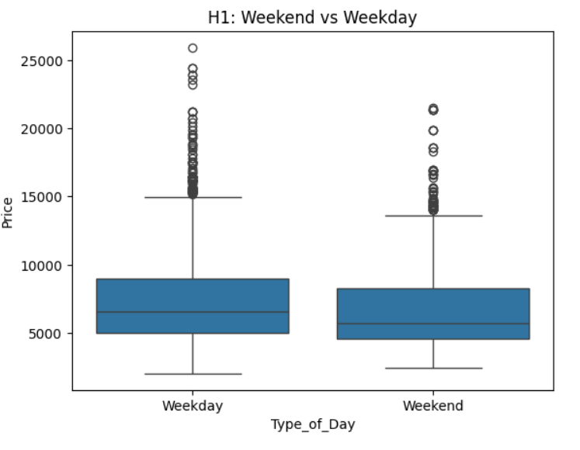
Hypothesis 1 (T-Test)
Are weekend flights more expensive than weekday flights?
Null Hypothesis (H0): There is no difference in mean ticket price between weekend and weekday flights.
Alternate Hypothesis (H1): Weekend flights have a different mean ticket price compared to weekday flights.
Decision: Reject Null Hypothesis.
Conclusion: Weekend flights tend to be priced differently compared to weekdays, suggesting a possible weekend premium or demand-based price adjustment.

Slide 30
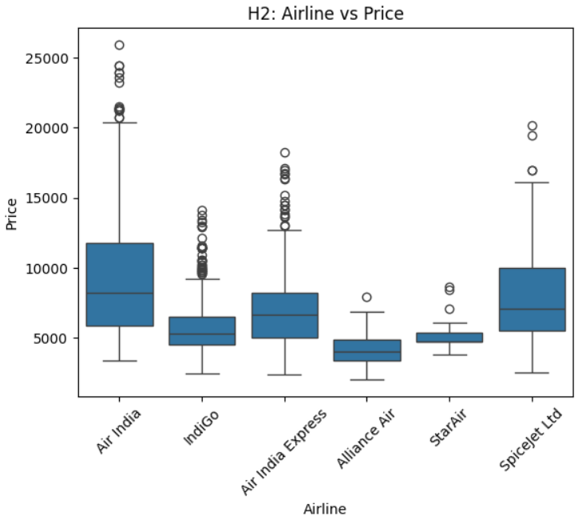
Hypothesis 2 (ANOVA)
Do different airlines charge different average ticket prices?
Null Hypothesis (H0): All airlines have equal mean ticket prices.
Alternate Hypothesis (H1): At least one airline has a different mean ticket price.
Decision: Reject Null Hypothesis.
Conclusion:
Airlines adopt different pricing strategies based on service level, operating costs, and market positioning.
Premium and full-service carriers tend to charge higher fares, while low-cost airlines compete more aggressively on price. For a traveler like

Slide 31
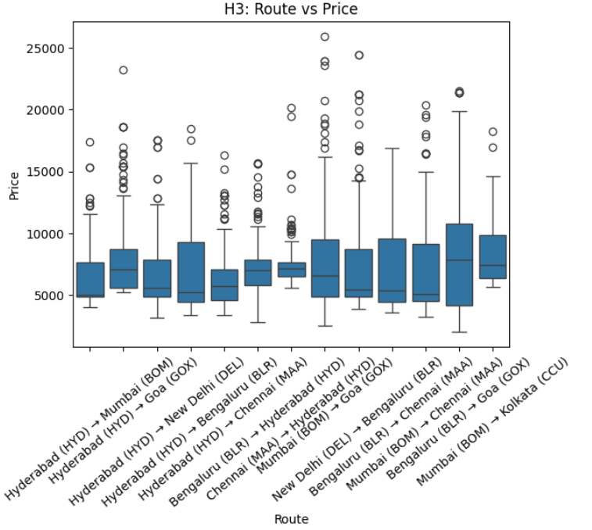
Hypothesis 3 (ANOVA)
Do different flight routes have different average ticket prices?
Null Hypothesis (H0): All routes have equal mean ticket prices.
Alternate Hypothesis (H1): At least one route has a different mean ticket price.
Decision: Reject Null Hypothesis.
Conclusion:
Route-specific factors such as demand, tourism patterns, business travel density, airport fees, and city connectivity influence pricing.
Busy business corridors may command premium fares, while tourist-heavy or low-demand routes may offer discounted pricing.

Slide 32
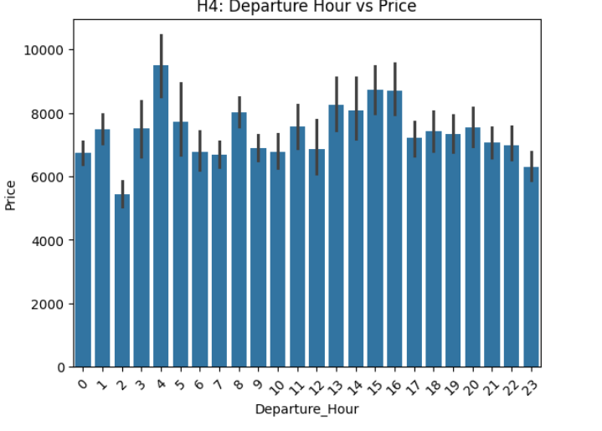
Hypothesis 4 (ANOVA)
Do different times of day have different average ticket prices?
Null Hypothesis (H0): All time-of-day groups have equal mean ticket prices.
Alternate Hypothesis (H1): At least one time-of-day group has a different mean ticket price.
Decision: Reject/Fail to Reject Null Hypothesis.
Conclusion: Airlines may charge differently for red-eye (late-night), peak business hours, or evening travel demand. Time slot pricing is a real airline practice influenced by convenience, demand, and business travel patterns.

Slide 33
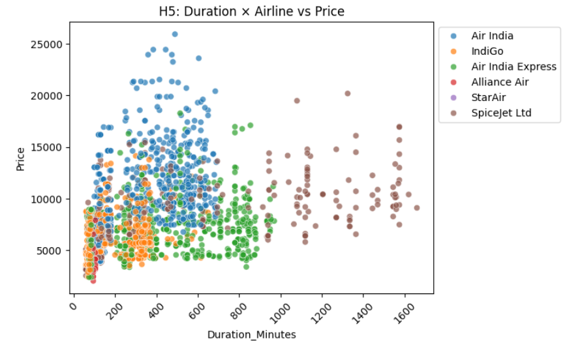
Hypothesis 5 (Two-Way ANOVA)
Do airline and flight duration jointly influence ticket prices?
Null Hypothesis (H0): Airline and duration have no effect on ticket prices.
Alternate Hypothesis (H1): Airline or duration or their interaction affects ticket prices.
Decision: Reject Null Hypothesis.
Conclusion:
Airline has a significant effect on ticket prices.
Duration has a significant effect on ticket prices.
The interaction between Airline and Duration is also significant.
This indicates that flight duration and airline choice do not operate independently on pricing.
Instead, different airlines adjust prices differently as flight duration changes.

Slide 34
Challenges I Faced
While Scraping the data the websites didn’t really give the permissions due to strong anti bot protection so I have to change to another website.
Dynamic pricing data changes rapidly — results not consistent at each refresh
Airport mismatch like for goa there are 2 airports so it became a issue while scraping goa data
Duration field stored as strings (e.g., “1h 45m”) → needed preprocessing
Hypothesis testing needed careful assumptions due to skewed distributions
Seaborn charts needed customization for readability

Slide 35
Key Recommendations
1. Compare Prices Across Airlines Before Booking
Different airlines price the same route differently. Checking multiple options can help avoid paying a premium for no added benefit.
2. Plan and Book in Advance When Possible
Weekday prices and last-minute fares are often higher due to business travel and demand spikes. Booking early helps secure better deals.
3. Check Route Variations and Stopovers
Some connecting routes or nearby airports can offer cheaper fares than direct flights. A small route change can save a lot of money.
4. Be Flexible with Travel Dates and Times
Prices change with demand, especially on weekends and peak hours. Shifting travel by a few hours or a day can reduce costs significantly.

Slide 36
Conclusion
Flight ticket prices vary significantly based on airline, route, duration, and time of travel
Weekend vs weekday fares differ — suggesting behavioral + demand-based pricing
Airlines follow different pricing strategies even on the same routes
Longer flight durations tend to command higher fares, but not proportionally
Outliers represent genuine market behavior (premium flights, demand spikes, limited seats) — not noise
Hypothesis testing confirms pricing is influenced by multiple interacting variables
For consumers, pricing is non-linear and timing-based; for airlines, pricing is by competitive and segmented
Flight fares are dynamic and multi-factorial, driven by airline strategy, demand patterns, and route economics, not just travel distance.

Slide 37

THANK YOU

